Slide 1
making your life easier
+
*
Brian Maitner
*(if you study plants)

Slide 2
Outline
1) Introduction and Motivation
2) What is BIEN?
Why do we need it?
How does it work?
What does it contain?
3) What is RBIEN?
How does it work?
What can I do with it?

Slide 3
Introduction
Some Big Questions in Ecology and Evolution:
What drives species richness patterns?
How have traits evolved within and across taxa?
What controls functional diversity?
How will climate change impact communities?

Slide 4
Introduction
Some Big Questions in Ecology and Evolution:
What drives species richness patterns?
How have traits evolved within and across taxa?
What controls functional diversity?
How will climate change impact communities?
Answering these will require BIG Data!

Slide 5
Introduction
Big Data in Ecology?
Lagging behind genetics (GenBank)
Lots of data, but not served very usefully (or at all)
Big, bad data (e.g. GBIF)
50% of plant names wrong
Only 33% of plant coordinates verifiably correct

Slide 6
Introduction
Big Data in Ecology?
What we need:
Open Access
Standardization
Conglomeration
Error checking

Slide 7
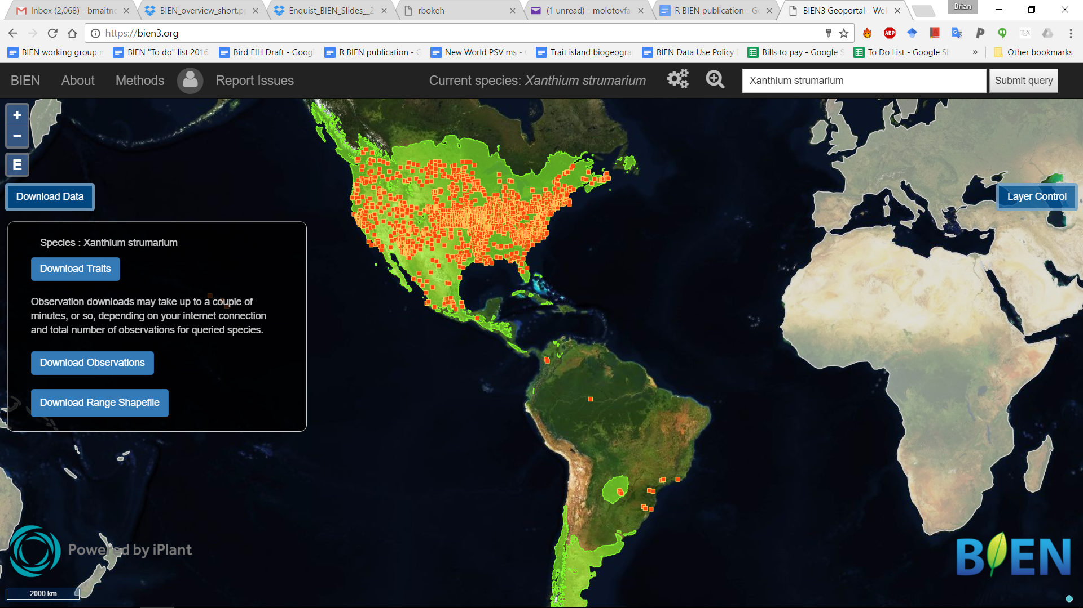
Introduction
Big Data in Ecology?
What we need:
Open Access
Standardization
Conglomeration
Error checking
This is where BIEN comes in!

Slide 8
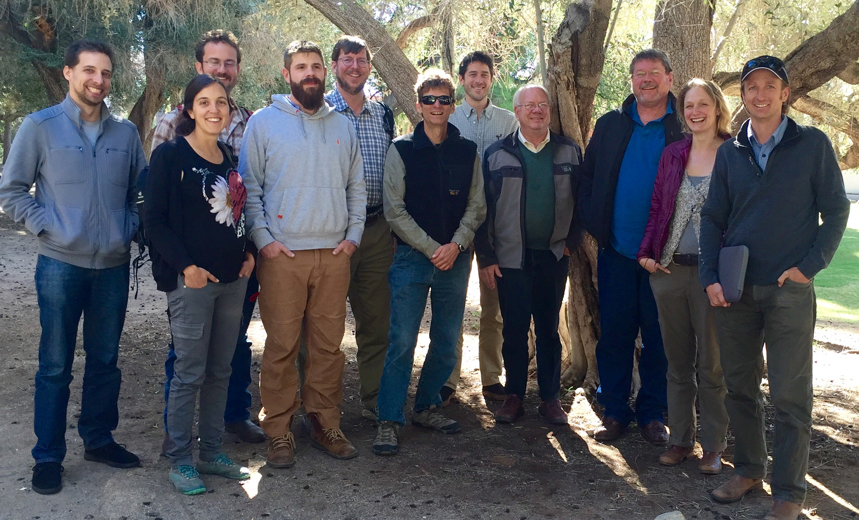
What is BIEN?
The Botanical Information and Ecology Network
Network of 50+ people at 20+ institutions
Ecologists
Evolutionary Biologists
Computer scientists
Informaticians
Collection managers
Taxonomists
and more…
1/5th of the BIEN group

Slide 9
The BIEN database
Additional validation:
Good coordinates?
Native?
Endangered?
Improved
Occurrence Data
Taxon scrubbing
Occurrence Data
Diverse data sources/formats
Plot Data
Trait Data
Range Maps
Phylogenetic Data
Taxonomic Data

Slide 10
The BIEN database
Additional validation:
Good coordinates?
Native?
Endangered?
Improved
Occurrence Data
Taxon scrubbing
Occurrence Data
Diverse data sources/formats
Plot Data
Trait Data
Range Maps
Phylogenetic Data
All of this is open-access and available!
Taxonomic Data

Slide 11
The BIEN database
 | Number observed within BIEN 3.4
Total Observations (Global) | 81,693,397
Specimens | 64,269,636
Plot observations | 17,423,761
Plots | 114,182
Species | 378,554
Trait measurements | 951,680
Ranges | 81,274
Taxonomic Data | 374,685
BIEN 3.4 Occurrence densities (per 100 km x 100 km cell)

Slide 12
The BIEN database
Accessing BIEN:
1) BIENdata.org
2) BIEN package for R (a.k.a. RBIEN)
3) POSTGRESQL

Slide 13
BIENdata.org

Slide 14
RBIEN: What is it?
A set of R functions to work with the BIEN database
Easier than learning SQL
Much easier than learning BIEN structure
Core goal of the package: make BIEN data easy to access

Slide 15
RBIEN: What is it?
Available on CRAN and Github
https://CRAN.R-project.org/package=BIEN
https://github.com/bmaitner/RBIEN
In R:
install.packages("BIEN")
install_github("bmaitner/RBIEN/BIEN")

Slide 16
RBIEN: What is it?
9 function families:
species lists
occurrence records
plot data
species range maps
trait data
taxonomic information
phylogenetic information
metadata
stem data

Slide 17
RBIEN: What is it?
9 function families:
species lists
occurrence records
plot data
species range maps
trait data
taxonomic information
phylogenetic information
metadata
stem data
Each family has a distinct prefix, e.g. :
BIEN_list_...
BIEN_occurrence_...

Slide 18
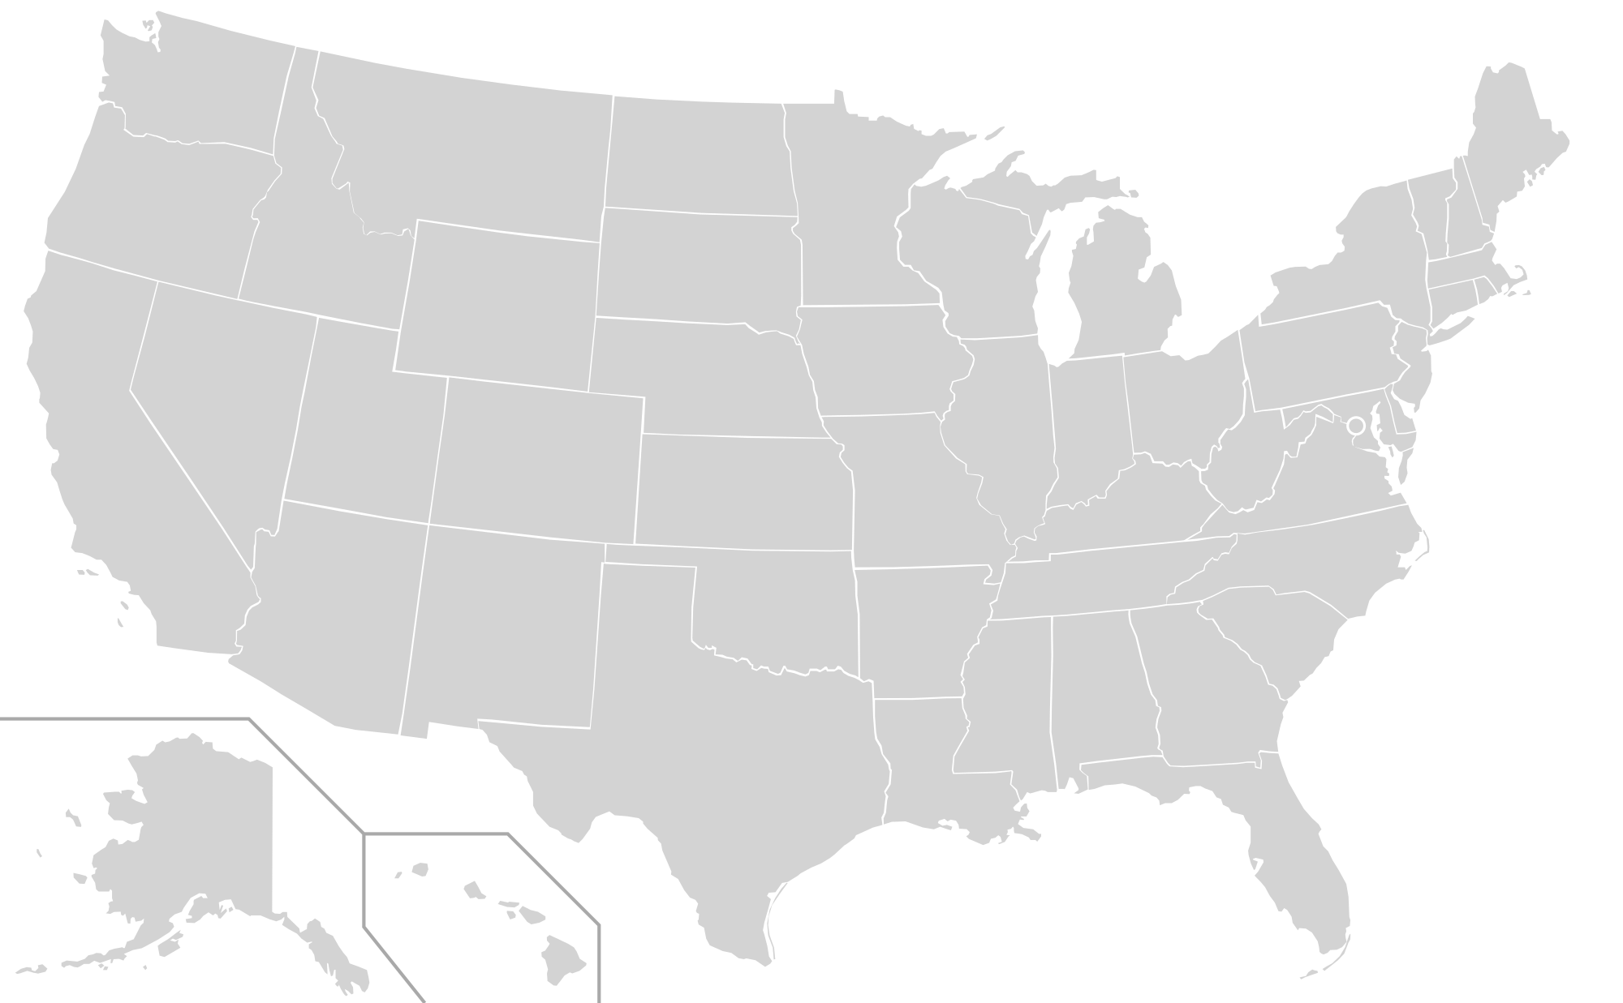
RBIEN: Species Lists
Prefix: BIEN_list_...
…all
…country
…state
…county
…shapefile

Slide 19
RBIEN: Species Lists
Prefix: BIEN_list_...
Example:
BIEN_list_county(country = "United States", state = "Arizona", county = "Pima")
Generates a list of all species with recorded occurrences in Pima county

Slide 20
RBIEN: Occurrence Records
Prefix: BIEN_occurrence_...
…country
…state
…county
…box
…shapefile
…family
…genus
…species
…records_per_species

Slide 21
RBIEN: Occurrence Records
Additional options:
cultivated
only.new.world
natives.only
all.taxonomy
native.status
observation.type
political.boundaries
Restrict search,
provide more information
more information
Occurrences of a single species

Slide 22
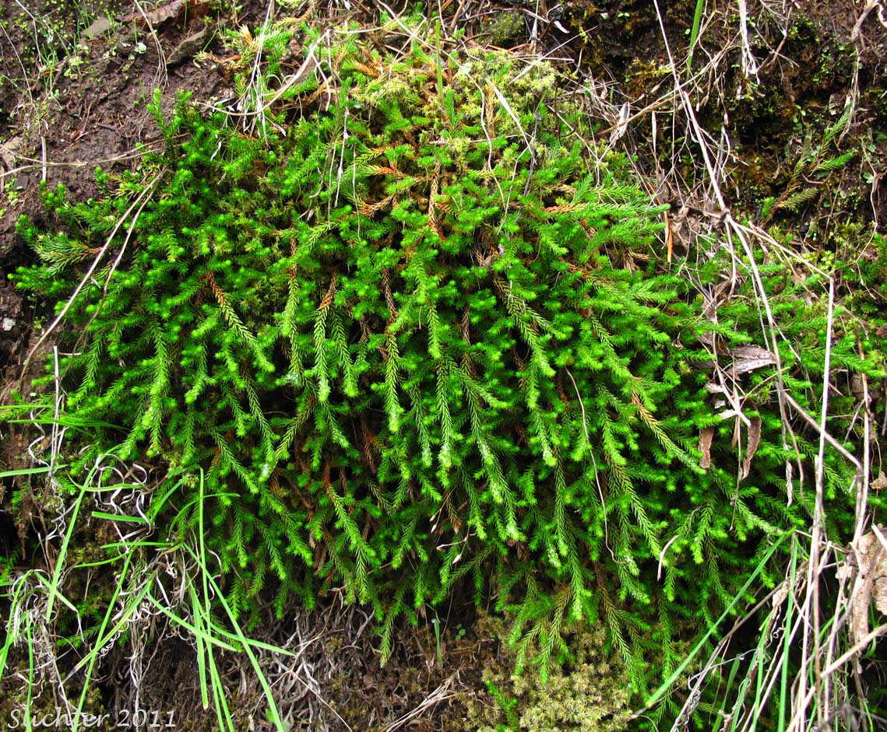
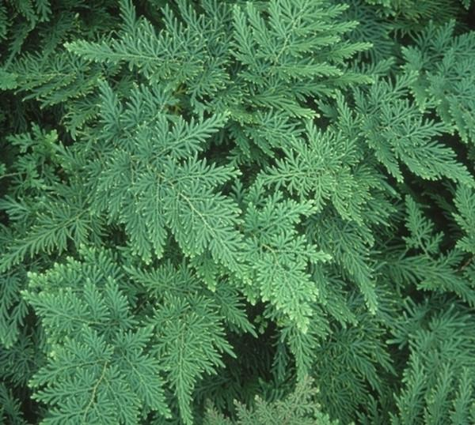
RBIEN: Occurrence Records
Example:
BIEN_occurrence_genus(
genus = "Selaginella",
only.new.world = F)
Downloads global records for Selaginella

Slide 23
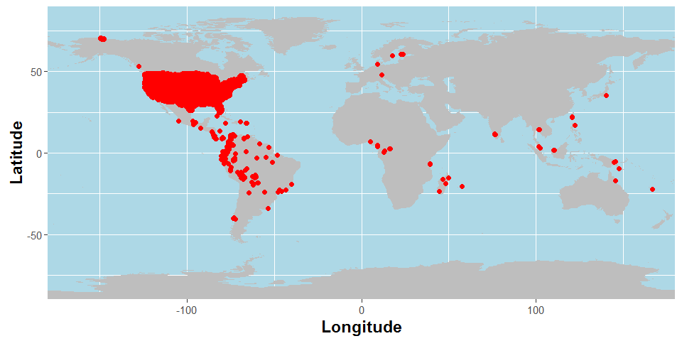
RBIEN: Plot data
Prefix: BIEN_plot_...
metadata
list_datasource
list_sampling_protocols
Good places to start with plot data
Useful info on which data meet your needs
Plot locations in BIEN 3.4

Slide 24
RBIEN: Plot data
Prefix: BIEN_plot_...
…dataset
…datasource
…sampling_protocol
…name
…country
…state
Plot locations in BIEN 3.4

Slide 25
RBIEN: Plot data
Additional options:
cultivated
only.new.world
natives.only
all.taxonomy
native.status
political.boundaries
all.metadata
more plot-specific metadata
Plot locations in BIEN 3.4

Slide 26
RBIEN: Plot data
Example:
BIEN_plot_state(
country = "United States",
state = "Rhode Island")
Plot locations in BIEN 3.4

Slide 27
RBIEN: Species range maps
Prefix: BIEN_ranges_...
…genus
…species
…load_species
…intersect_species
…box
…shapefile
taxonomic queries
spatial queries

Slide 28
RBIEN: Species range maps
Prefix: BIEN_ranges_...
…genus
…species
…load_species
…intersect_species
…box
…shapefile
loads maps into
environment

Slide 29
RBIEN: Species range maps
Additional options:
directory
matched
match_names_only
return.species.list
species_names_only
crop.ranges
VERY IMPORTANT!

Slide 30
RBIEN: Species range maps
Example:
library(maps)
library(maptools)
xs<-BIEN_ranges_load_species(
species= "Xanthium strumarium")
map('world',xlim = c(-180,-20))
plot(xs, add=TRUE, col="green")

Slide 31
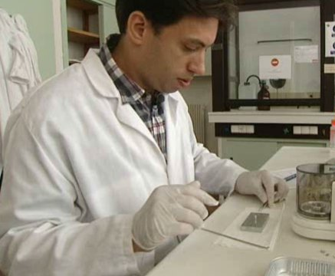
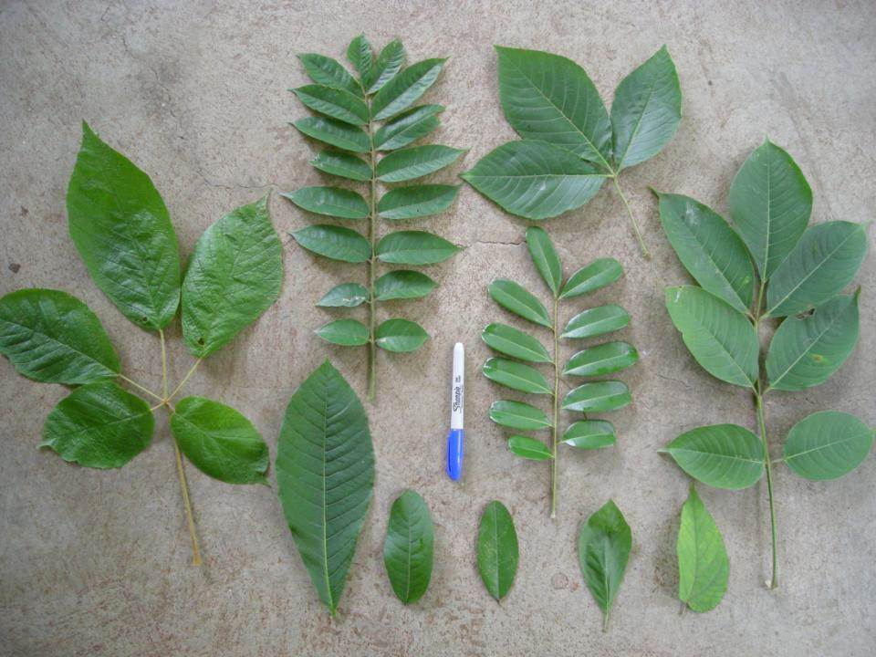
RBIEN: Trait Data
Prefix: BIEN_trait_...
…list
…trait
…traitbyfamily
…traitbygenus
…traitbyspecies
…traits_per_species
…mean
…family
…genus
…species
Image: catherinehulshof.wordpress.com

Slide 32
RBIEN: Trait Data
Prefix: BIEN_trait_...
…list
…trait
…traitbyfamily
…traitbygenus
…traitbyspecies
…traits_per_species
…mean
…family
…genus
…species
Useful metadata
trait queries
taxonomic queries
Image: catherinehulshof.wordpress.com

Slide 33
RBIEN: Trait Data
Start with BIEN_trait_list
Spelling matters
“leaf area” ≠ “Leaf Area”
Standardized names, units
31 traits (more to come)
Image: catherinehulshof.wordpress.com

Slide 34
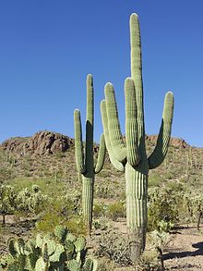
RBIEN: Trait Data
Example:
BIEN_trait_genus("Carnegiea")
Downloads all trait data for saguaros

Slide 35
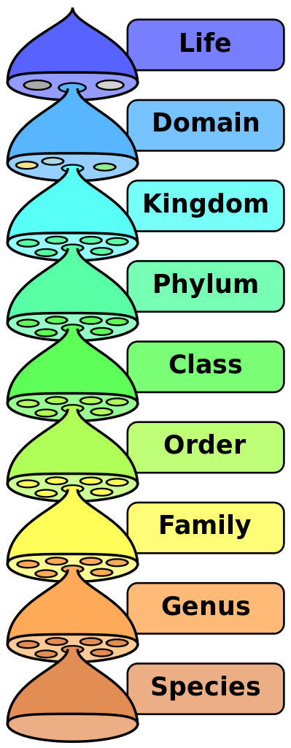
RBIEN: Taxonomic Data
Prefix: BIEN_taxonomy_...
…family
…genus
…species

Slide 36
RBIEN: Taxonomic Data
Prefix: BIEN_taxonomy_...
…family
…genus
…species
Also contains authorship, validity data

Slide 37
RBIEN: Taxonomic Data
Example:
BIEN_taxonomy_family("Selaginellaceae")
Downloads taxonomic data for the whole family

Slide 38
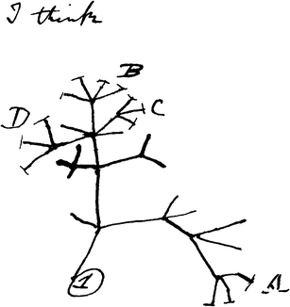
RBIEN: Phylogenies
Prefix: BIEN_phylogeny_....
…conservative
…complete

Slide 39
RBIEN: Phylogenies
Prefix: BIEN_phylogeny_....
…conservative
…complete
Only species w/ molecular data (19k), 1x
Most New World species (81k), 100x

Slide 40
RBIEN: Phylogenies
Prefix: BIEN_phylogeny_....
…conservative
…complete
Additional options:
n_phylogenies
seed
replicates
Only species w/ molecular data (19k), 1x
Most New World species (81k), 100x
Randomly select phylogenies
Specify phylogenies for download

Slide 41
RBIEN: Phylogenies
Example:
phylo <- BIEN_phylogeny_conservative()
library(ape)
plot.phylo(phylo, show.tip.label = F)

Slide 42
RBIEN: Metadata
Prefix: BIEN_metadata_...
…database_version
…match_data
…citation

Slide 43
RBIEN: Metadata
Prefix: BIEN_metadata_...
…database_version
…match_data
…citation
Generates attribution data!
References
Acknowledgements

Slide 44
RBIEN: Metadata
Example:
selaginella <- BIEN_occurrence_genus("Selaginella")
BIEN_metadata_citation(dataframe = selaginella)
Returns:
1) Information on data use
2) Bibtex citations for use in a reference manager
3) Acknowledgement statement for manuscripts

Slide 45
RBIEN: Caveats and tips
Computer and network need to allow SQL connections
Some queries may take a long time, be patient
Let me know if something is documented poorly

Slide 46
BIEN: Future Directions
Improve Old World data coverage
More, improved range maps
More trait data
Allow users to upload trait, occurrence data
Feedback to data providers (errors, number of downloads)

Slide 47
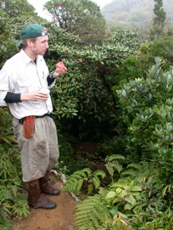
Questions? Suggestions?
Thanks to the entire BIEN working group, especially:
Brad Boyle
Cory Merow
Daniel Guaderrama
Brian Enquist

